Slide 1
Introduction to infinite series
Da Zhou （周达）
zhouda@xmu.edu.cn

Slide 2
Partial sums

Slide 3
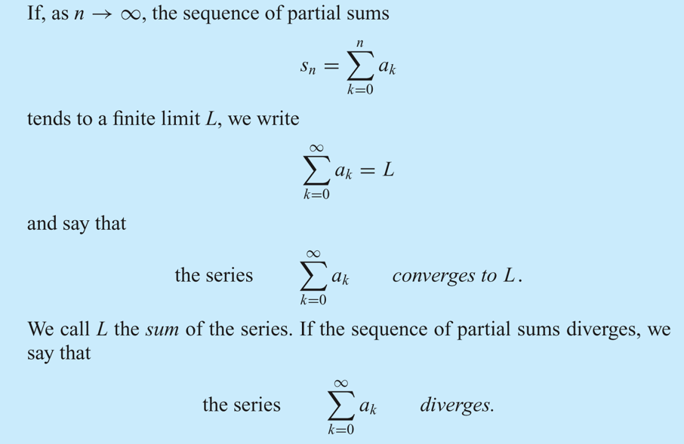
Infinite series, convergence and divergence

Slide 4
Bounded and unbounded divergence

Slide 5
Example: The Geometric Series
The geometric progression 1, x, x², x³, . . . gives rise to the numbers 1, 1 + x, 1 + x + x², 1 + x + x² + x³, . . . .
These numbers are the partial sums of what is called the geometric series:

Slide 6
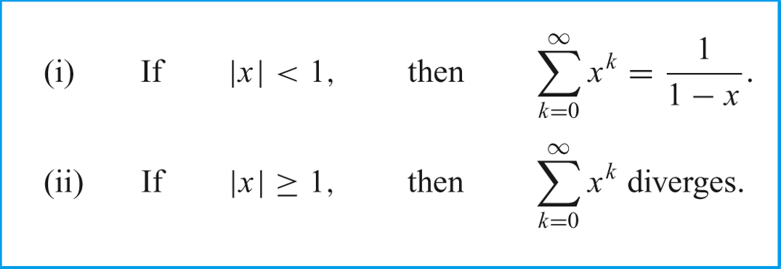
For the Geometric Series

Slide 7
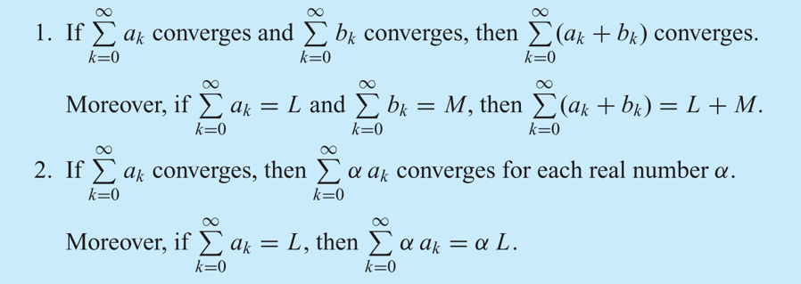
Properties of infinite series

Slide 8
Properties of infinite series

Slide 9
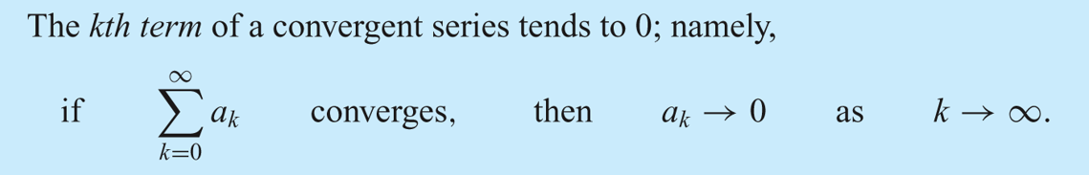
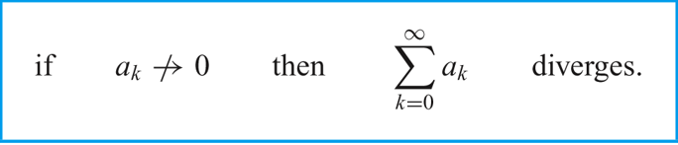
Properties of infinite series

Slide 10
Example

Slide 11
Positive (nonnegative) series
Series with positive (nonnegative) terms

Slide 12
Positive (nonnegative) series
Series with positive (nonnegative) terms
Basic Theorem:

Slide 13
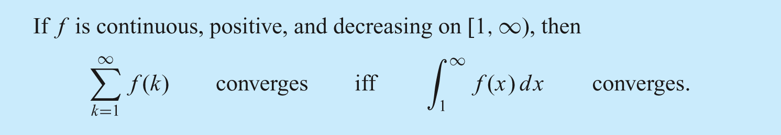
(I) Integral Test

Slide 14
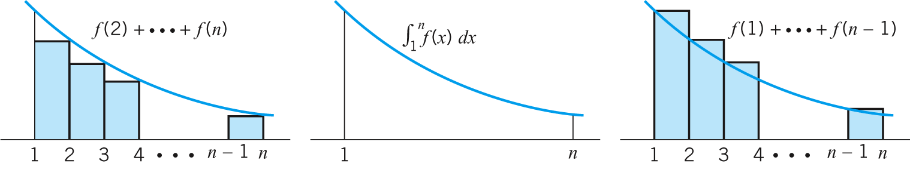
(I) Integral Test

Slide 15
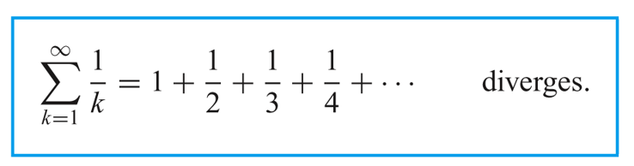
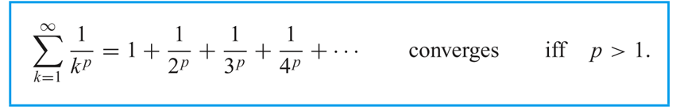
Two special series
Harmonic series
p-series

Slide 16
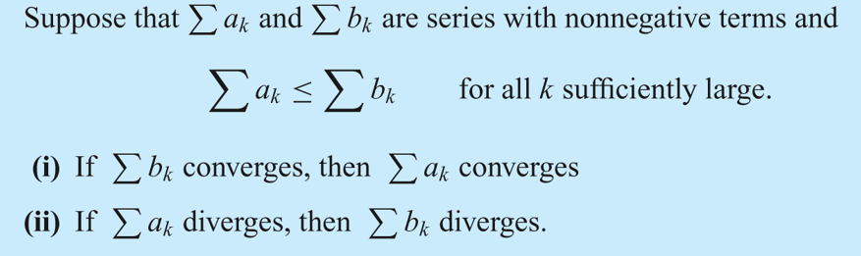
(II) Basic comparison test

Slide 17
Examples

Slide 18
Examples

Slide 19
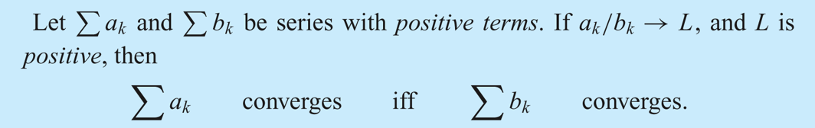
The limit comparison test

Slide 20
Examples

Slide 21
Examples

Slide 22
Exercises

Slide 23
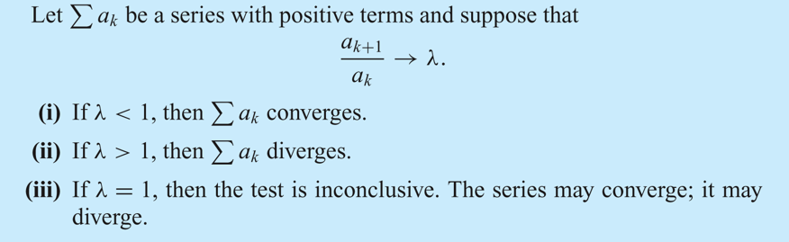
(III) The ratio test

Slide 24
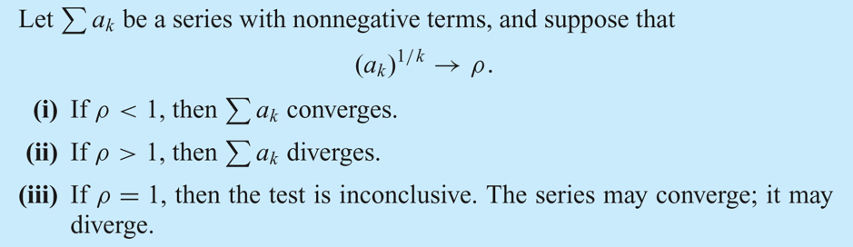
(IV) The root test

Slide 25
Examples

Slide 26
Examples

Slide 27
Examples

Slide 28
Exercises

Slide 29
Exercises

Slide 30
Alternating Series
(a_{k} is positive)

Slide 31
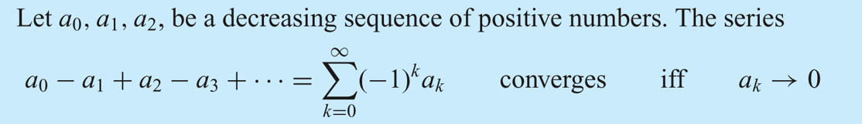
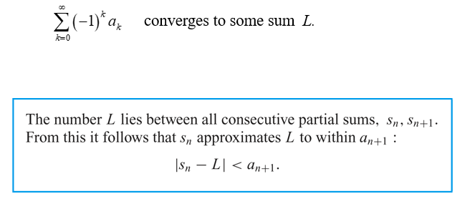
Leibniz Theorem

Slide 32
Examples

Slide 33
Examples

Slide 34
Absolute and conditional convergence
Series Σa_{k} for which Σ|a_{k}| converges are called absolutely convergent;
Convergent series Σa_{k} for which Σ|a_{k}| diverges are called conditionally convergent.

Slide 35
Given Σa_{k}
Step 1: Check if Σ|a_{k}| converges or not; If yes, say that “Σa_{k} is absolutely convergent”; If no, continue to Step 2.
Step 2: Check if Σa_{k} converge or not; If yes, say that “Σa_{k} is conditionally convergent”; If no, say that “say that “Σa_{k} is divergent”.

Slide 36
Exercises

